Slide 1
THE KING COUNTY HOUSE SALES PROJECT BENTA W. IRUNGU 26th MARCH,2023

Slide 2
Outline
Business understanding
Data understanding
Data preprocessing
Exploratory data analysis
Modeling & evaluation
Results
Conclusions & recommendations

Slide 3
Business understanding
This project uses the king county house sales data sets to understand the paterns and trends of sale of houses in King county, Washington, USA.
This project targets the real estate investor as the stakeholder. The real estate investor may benefits from this data to identify profitable houses in the area and use the information to make informed decisions on what houses to invest in.
business problem: predicting the sale price of houses in King County using a predictive model that can accurately forecast the sale price of houses in the area. The model will be used to identify undervalued properties and inform investment decisions.

Slide 4

Data undesranding
The process of data understanding involved
1.Loading the kc_house_data.csv file into the notebook.
2. Checking the number of observations in the data using the .shape function.
3. Checking the types of the data in the columns using the .dtype function
4. Checking the statistical summary of the data using the .describe function

Slide 5
DATA PREPARATION
The data preparation process included;
data cleaning
feature engineering
feature selection
checking for multicolinearity
data normalization

Slide 6
Data cleaning
Checked the missing values
Replaced missing values in the column `waterfront` as it was the only column we aimed at using that had a missing value. We replaced the missing values with the median

Slide 7



Feature engineering
Data shape before | Adding column | Data shape after adding column ‘age’
Added a new feature, ‘age’, by subtracting current year from ‘yr_built’ column.

Slide 8
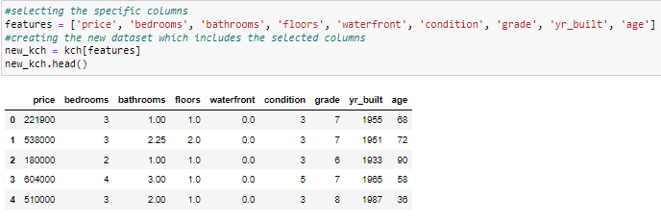
Feature selection
We created a data frame with selected features that we intend to use in the project.

Slide 9
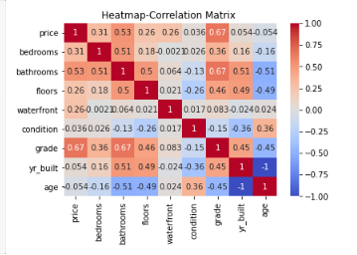
checking for multicolinearity
We checked for multicolinearity using the correlation matrix. See visualization below

Slide 10
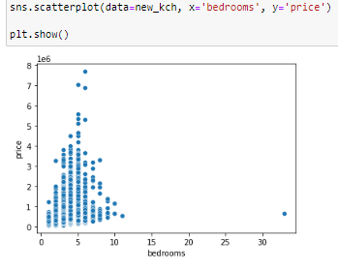
EXPLORATORY DATA ANALYSIS (EDA)
After data cleaning we did some data exploring
Visualizing the relationship between the number of bedrooms and the price of the houses using a scatter plot:

Slide 11
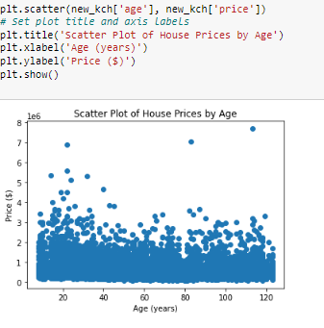
Cont…
2. Visualizing the relationship between the number of bedrooms and the price of the houses using a scatter plot:

Slide 12
MODELING AND EVALUATION
The study used to models
Baseline model: had the target variable price as the feature only
Predictor model: used 4 predictor variables namely ‘bedrooms’, ‘floors’, ‘condition’ and ‘grade’. ‘price’ was used as the outcome/target variable.

Slide 13
Baseline model
We built a baseline model which was a regression model and fitted the X_train and y_train data.
The model train and test predictions are as follows;

Slide 14
Cont…
Baseline model evaluation
The model was evaluated using
1. the MSE and R-squared.
The model had a MSE of 1.3 and an R-squared of 1 which indicated overfitting.
2. cross_validate and ShuffleSplit
The mode had a train score of 1 and a validation score of 1 which also indicated overfitting .
The overfitting neccisated a second model, which we named predictor model

Slide 15
Predictor model
The features of the model were selected after visualizing all the predictor features against the target variable using scatter plots(refer to notebook).
Model evaluation
The model was evaluated using the cross_varidate and shuffle split. The model had a train score of 0.47 and validation score of 0.48
The model did not indicate multicollinearity so we adopted it

Slide 16
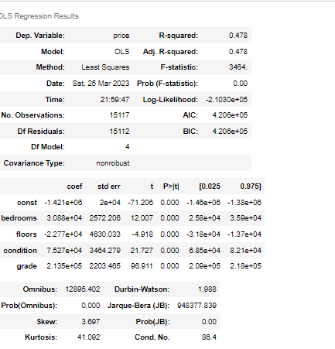
Predictor model summary

Slide 17
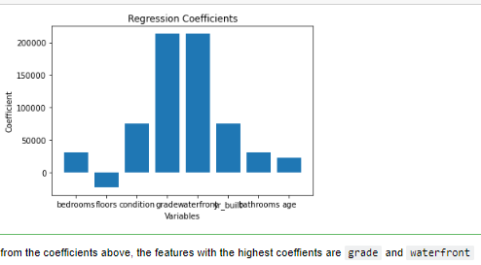
FINDINGS
To deploy the model, we used it to check for the coefiicients of the defined predictor variables. The results are as visualized below; X = ['bedrooms', 'floors', 'condition', 'grade', 'waterfront', 'yr_built','bathrooms','age']
coef = [30884.665051, -22769.040353, 75269.163979, 213539.771749, 213539.771749, 75269.163979, 30884.665051, 22769.040353 ]

Slide 18
Conclusions
Based on the coefficients, the most important variables in predicting the price of houses are the grade and the waterfront of the property.
Condition, number of bedrooms and bathrooms also have a significant positive impact on the price.
The Number of floors in a house seems to have a negative impact on the price of the house. the more the number of floors the less the price of the house

Slide 19
RECOMMENDATIONS
The real estate investor should focus on properties with higher grades and those located on waterfronts as they have the highest coefficients and therefore, will likely have a higher resale value.
Properties with a good condition, higher number of bedrooms and bathrooms are also likely to have a positive impact on the price.
The number of floors in a house seems to have a negative impact on the price of the house, so the investor should be cautious when considering multi-story properties.
The investor consider the interaction between variables when making investment decisions. For example, a waterfront property with a high grade and good condition may have a higher resale value than a waterfront property with a low grade and poor condition.

Slide 20
Future Considerations
The following aspects should be considered in the future analysis
1. Collecting more data: Collecting more data may help to improve the accuracy of the model. For example, it may be helpful to collect data on other variables that could potentially impact house prices, such as the size of the lot, the proximity to schools, or the crime rate in the neighborhood.
2. Feature engineering: Feature engineering involves creating new features that may be more predictive of the target variable. For example, we could create a new feature that calculates the average price of houses in the same zip code as the house being sold.

Slide 21
Thank You!
Email: bentairungu@gmail.com
GitHub: b-irungu
LinkedIn: https://www.linkedin.com/in/benta-irungu-a6358513a

